Slide 1

List Comprehension, Memory Management, and Lambda Expression

Slide 2
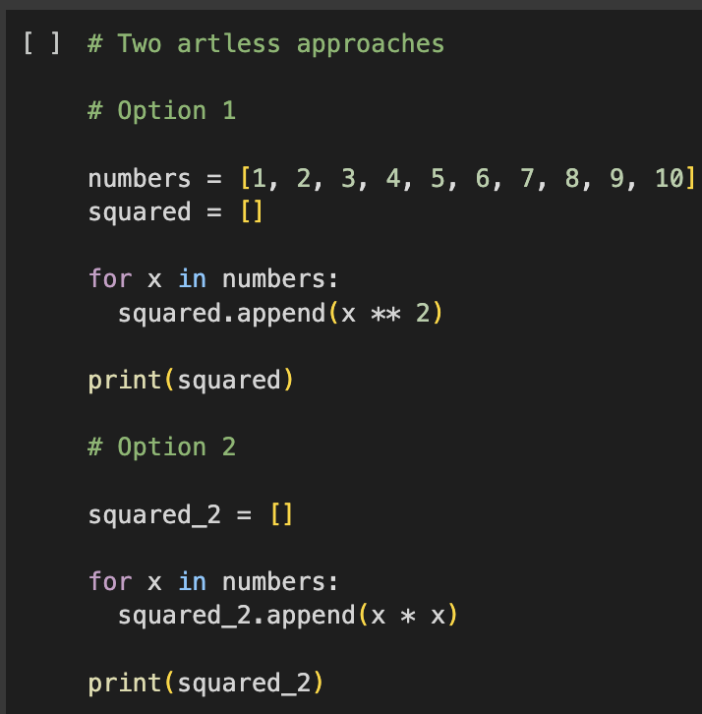
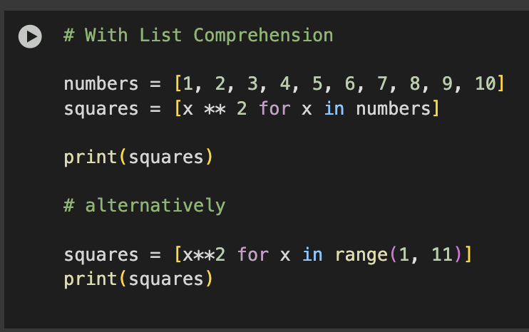
Solve this…
Create a list of 10 numbers and compute their square value:
1, 2, 3, 4, 5, 6, 7, 8, 9, 10

Slide 3
List Comprehensions
Offer a concise way to create new lists from existing iterables
Work with any iterable, including lists, strings, and tuples
Syntax includes:
A New List
An expression
A for clause
Optionally, additional for or if clauses
Why Use Them?
Provide a compact alternative to standard for loops
Help you write cleaner, shorter code
Ideal for simple transformations or filtering
Often faster than loops

Slide 4
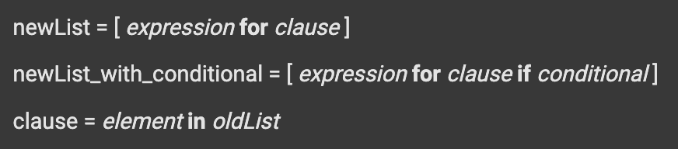
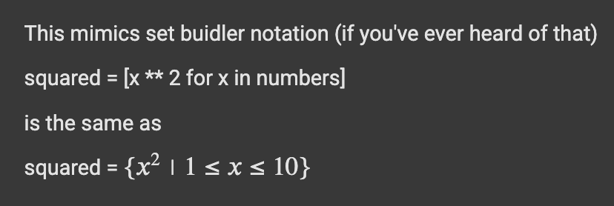
List Comprehension
Python List comprehension provides a much shorter syntax for creating a new list based on the values of an existing list.

Slide 5
Let’s explore more sophisticated constructions in Google Colab
Conditional Statements
Additional Syntax
Dealing with Tuples
Nested Loops
Time Analysis

Slide 6

List Comprehension
Why do we care about writing code via List Comprehension if at the end we got the same answer? right?
In general, list comprehensions are faster than for-loops.

Slide 7
Let’s move to another subject…
How is data-storage managed while working on Python?
As Data Scientist, we care about writing efficient code that runs fast.
But also…
writing efficient code means writing a memory-efficient code

Slide 8
Memory Management for Python
CPython
Reference implementation of Python
All new language features start here
Other implementations exist for certain use cases
Private Heap:
All Python objects/data reside in a private heap
Managed internally by the Python Memory Manager
Memory Allocation Layers:
Raw allocator interacts with OS to reserve heap memory
Object-specific allocators manage memory for types like int, str, dict, etc.
Garbage Collection:
Frees memory no longer in use
Object is deallocated when ref count = 0
Per-Object Memory Handling:
Each object has its own allocator & deallocator
Global Interpreter Lock (GIL):
Only one thread can execute Python bytecode at a time when accessing shared data

Slide 9
Memory Management for Python (a company analogy)
CPython (Company Headquarters):
Reference implementation of Python
All new language features start here
Other implementations exist for certain use cases
Private Heap:
All Python objects/data reside in a private heap (a company's private warehouse)
Managed internally by the Python Memory Manager (architect overseeing project)
Memory Allocation Layers:
Raw allocator interacts with OS to reserve heap memory (bricks for warehouse)
Object-specific allocators manage memory for types like int, str, dict, etc. (rooms in warehouse)
Garbage Collection:
Frees memory no longer in use (cleanup crew)
Object is deallocated when ref count = 0 (tool/material sign-out sheet)
Per-Object Memory Handling:
Each object has its own allocator & deallocator (type-specific storage bins in each room)
Global Interpreter Lock (GIL):
Only one thread can execute Python bytecode at a time when accessing shared data (single checkout line, safe but slow)

Slide 10
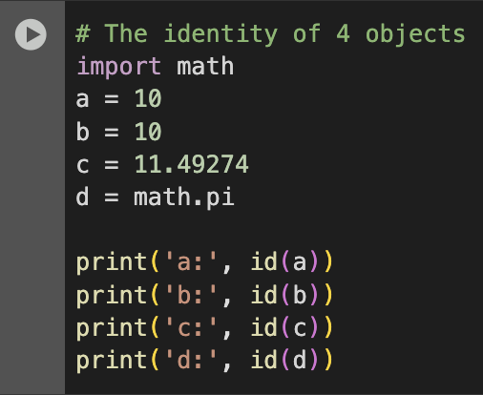
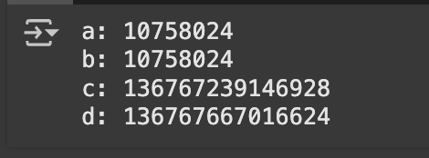
Memory Management for Python
id(object) = memory address (identity) of an object

Slide 11
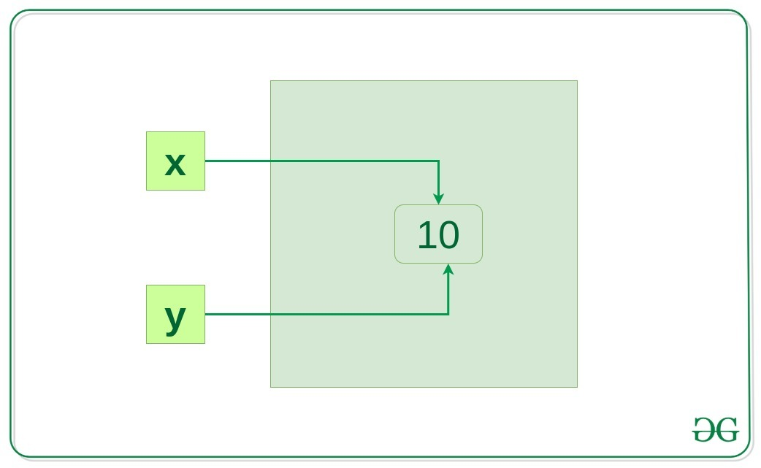
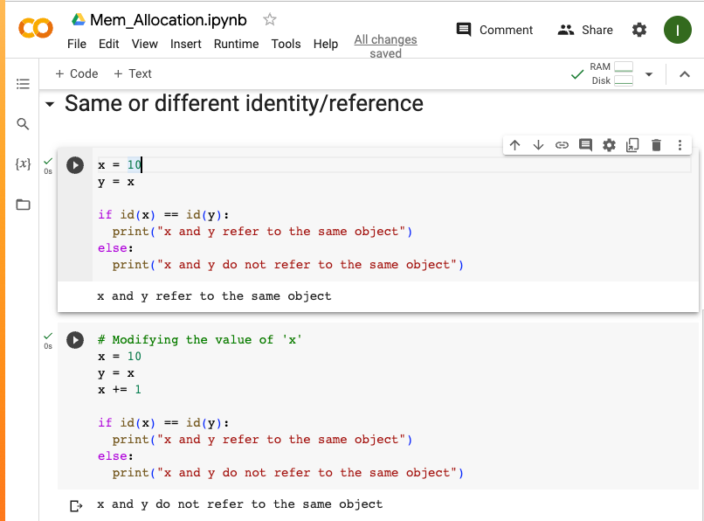
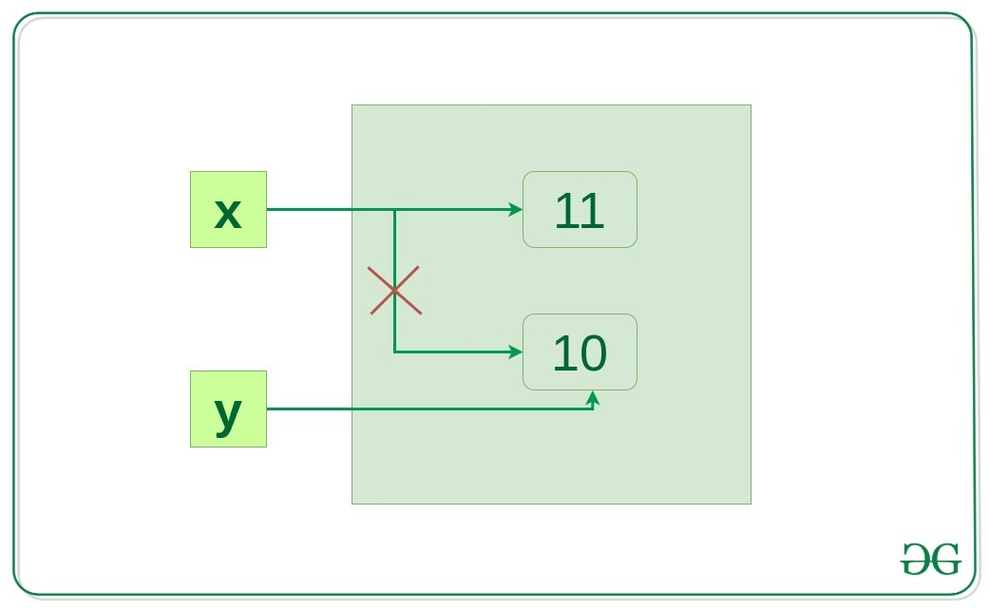

Slide 12
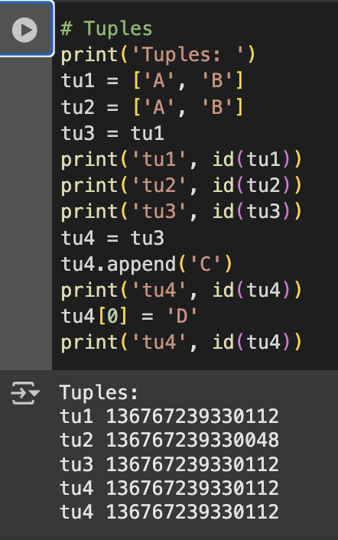
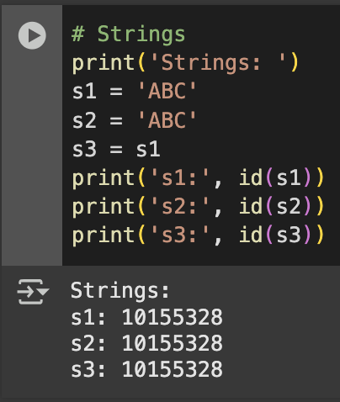
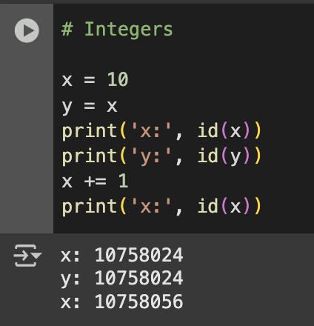

Slide 13
Lambda Functions
A lambda function is a small, anonymous function in Python.
Created using the lambda keyword.
lambda expression syntax: lambda parameters: expression
Returns the result of the expression automatically (no return needed).
Promotes abstraction, key to programming— you focus on what the function does, not how it works internally.

Slide 14
Lambda Functions
Advantages
Concise: Define simple functions in a single line.
Anonymous: No need to name them if used once.
Flexible: Pass directly into higher-order functions.
Readability: Useful when function logic is short and obvious.

Slide 15
Lambda Functions
The following terms may be used interchangeably depending on the programming language type and culture:
Anonymous functions
Lambda functions
Lambda expressions
Lambda abstractions
Lambda form
Function literals

Slide 16
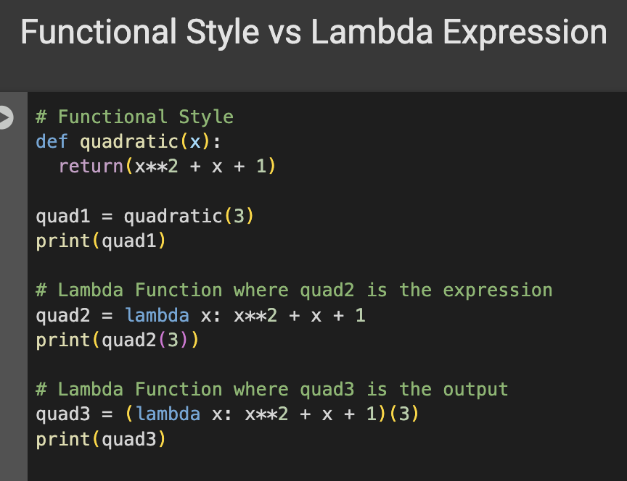
Keyword: lambda
Parameters(s): x
Expression: x**2 + x + 1

Slide 17
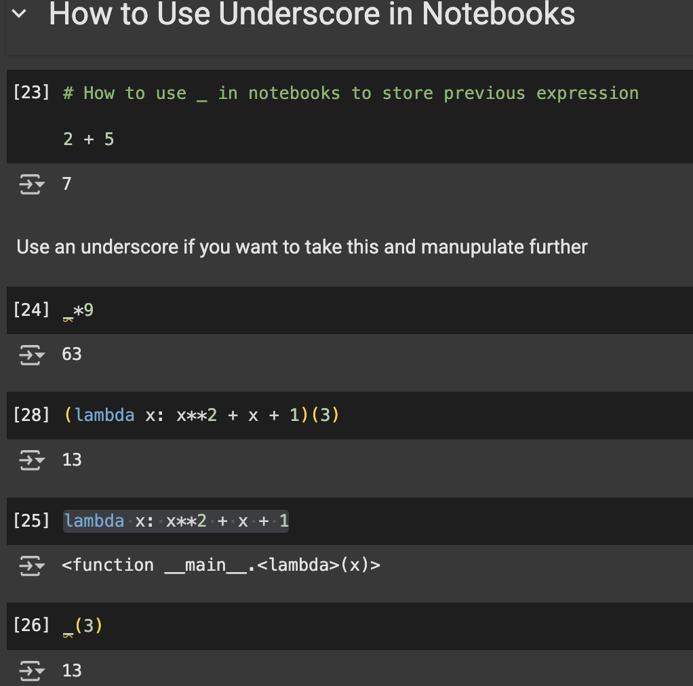
Syntax to evaluate directly:
(lambda function)(input)

Slide 18
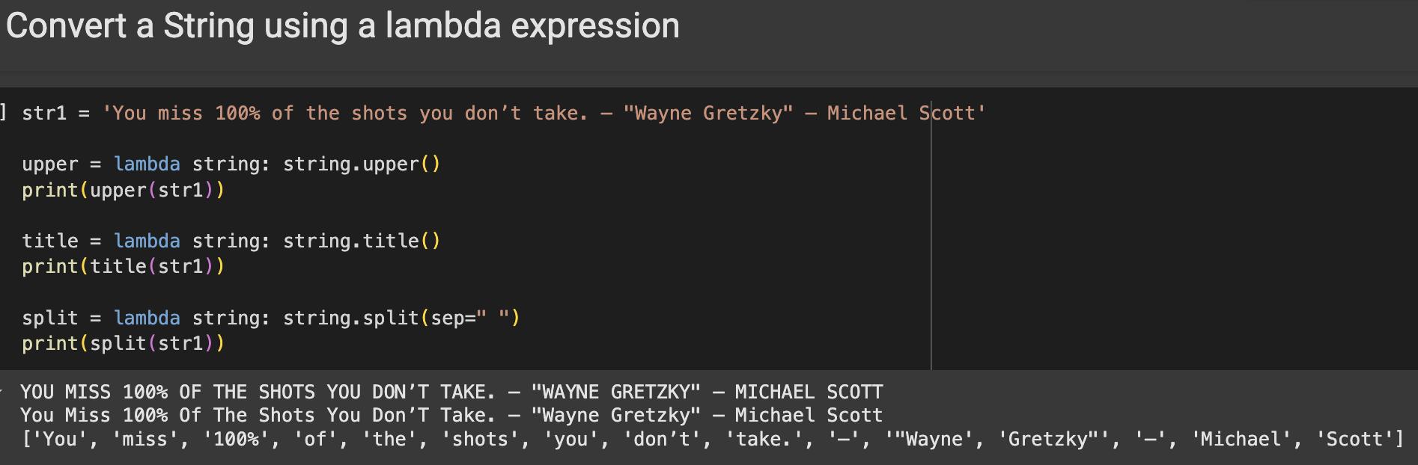

Slide 19
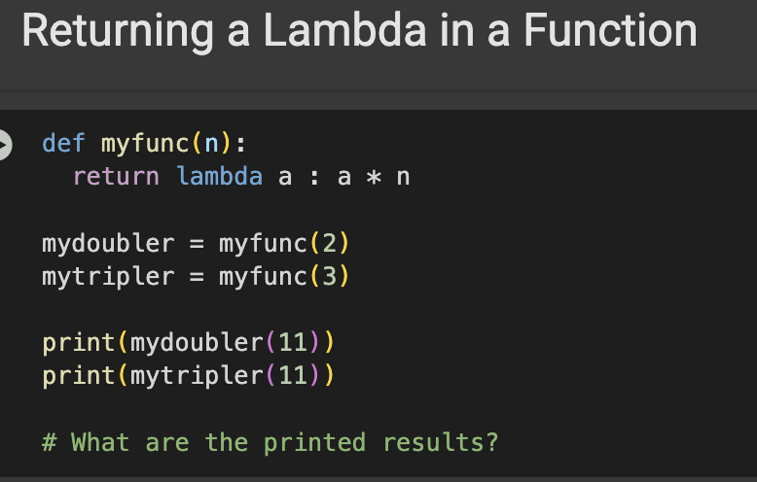

Slide 20
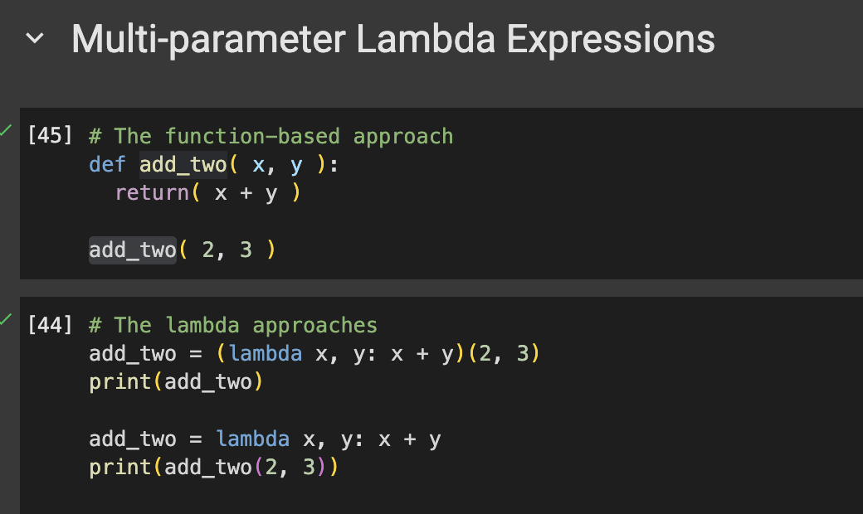

Slide 21
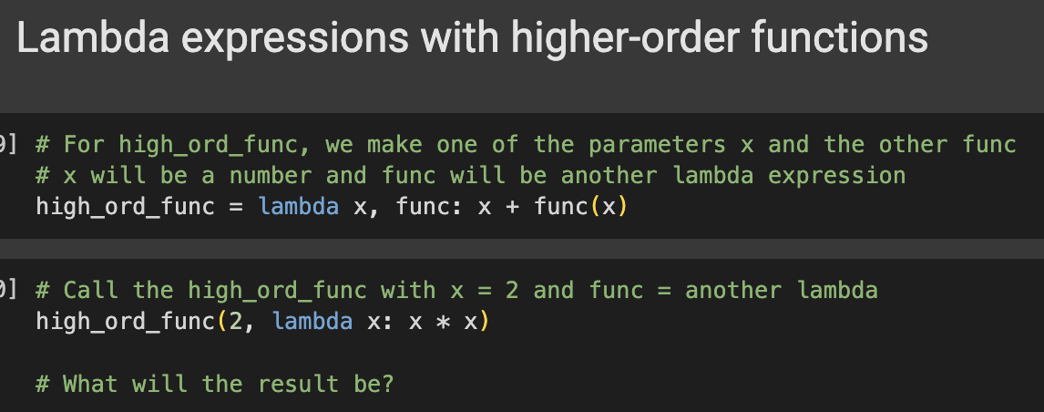
Higher Order Functions
A higher-order function is a function that takes other functions as arguments or returns a function as a result.

Slide 22
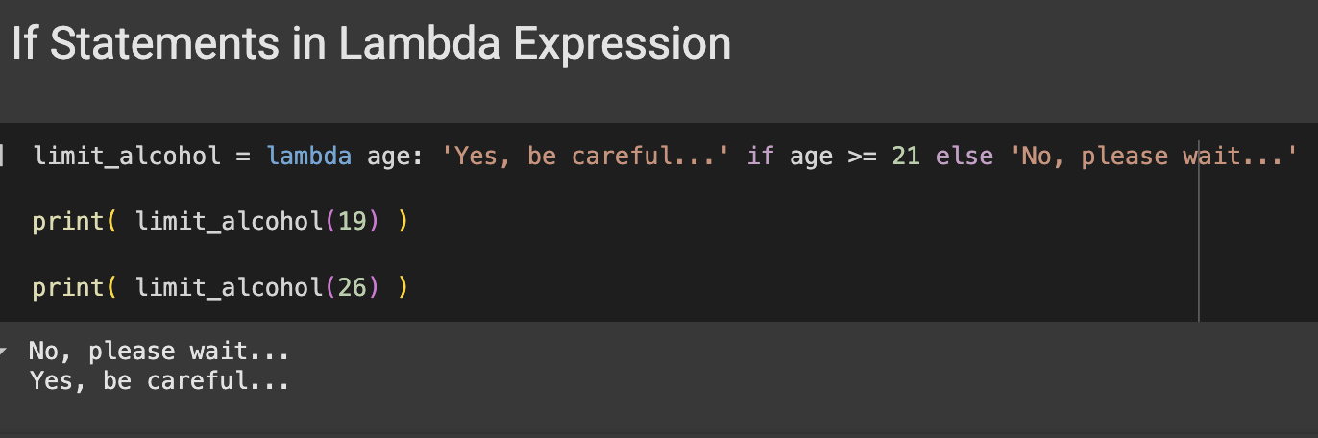

Slide 23
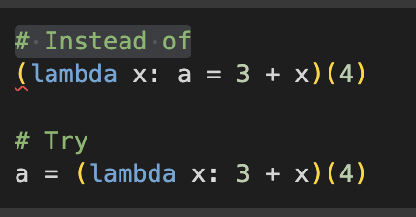
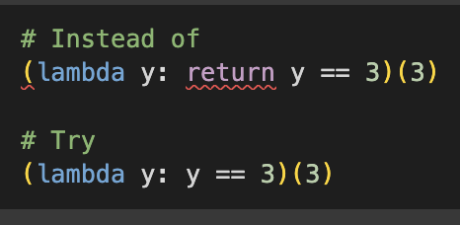
Some Syntax Limitations

Slide 24
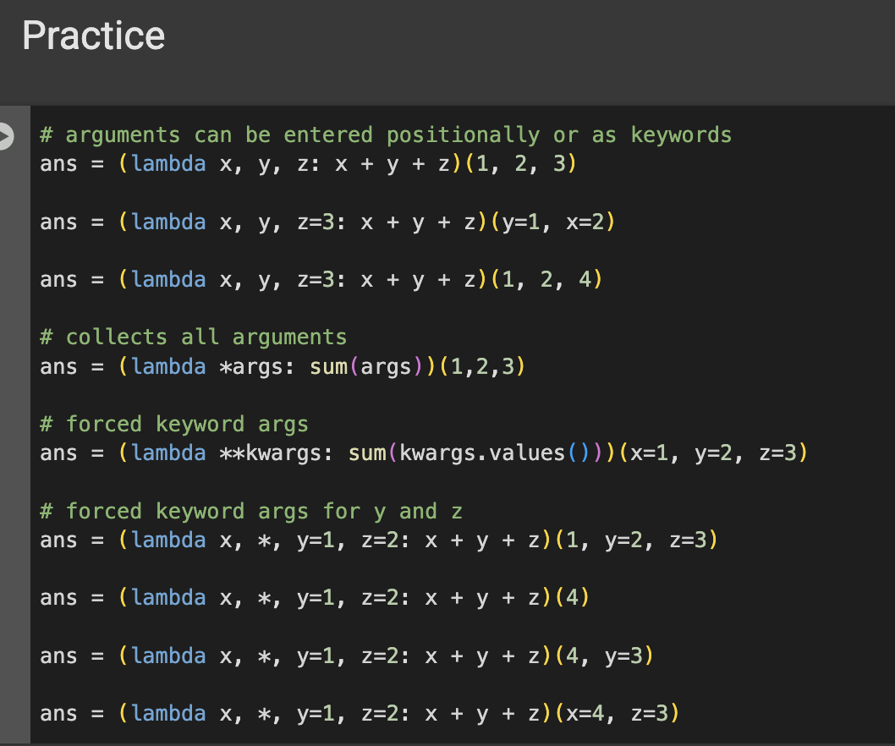

Slide 25
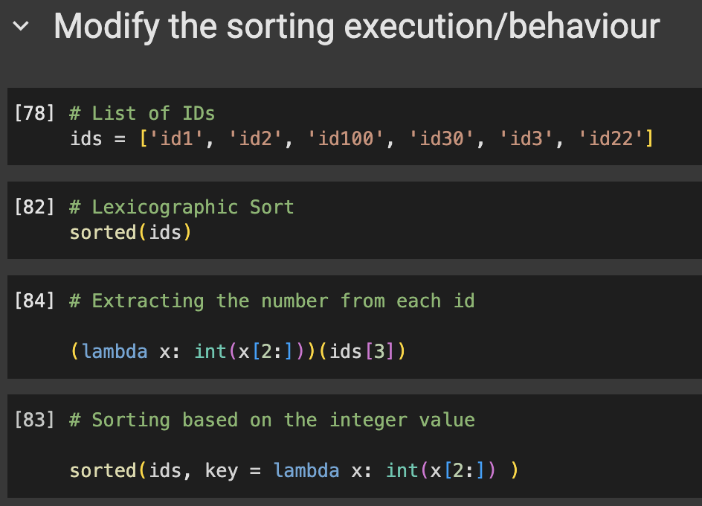

Slide 26
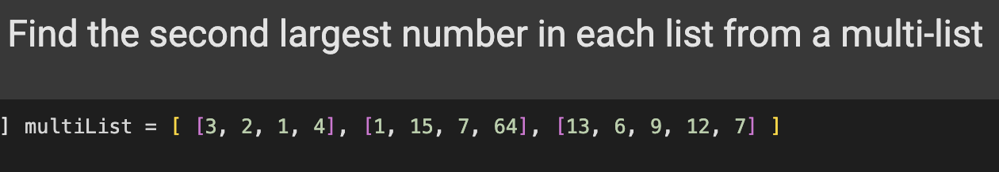
Some Examples

Slide 27
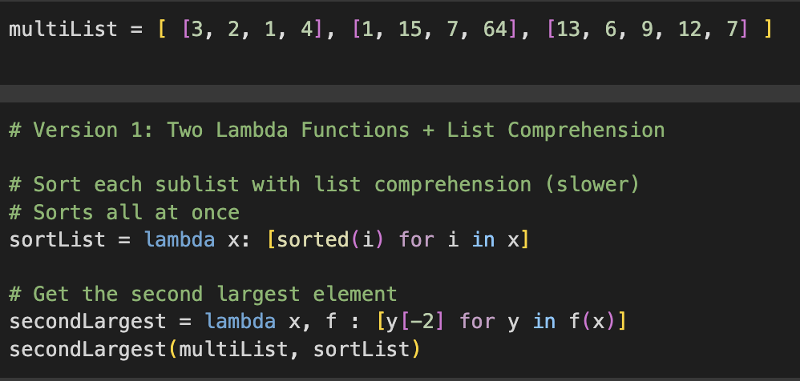

Slide 28
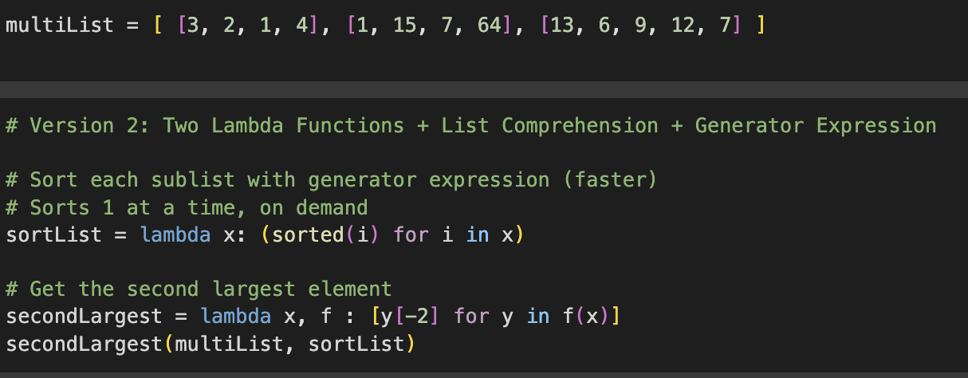

Slide 29
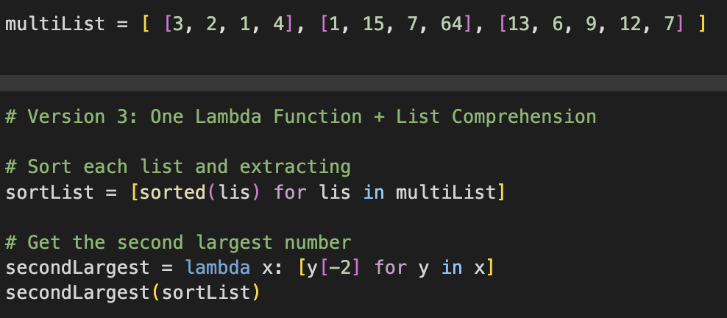

Slide 30
